Slide 1

OLIST STORE ANALYSIS

Slide 2
Introduction about this Project :
1. This project is about studying sales data from the Olist Store to understand how the business is doing.
2. The dashboard shows important details like top and bottom products, cities, and states by sales.
3. It also shows how people pay, average delivery days, and customer review scores.
4. I used tools like Power BI / Tableau / Excel to make the charts and visuals easy to understand.
5. This dashboard helps to quickly find what’s working well and where the store can improve.

Slide 3
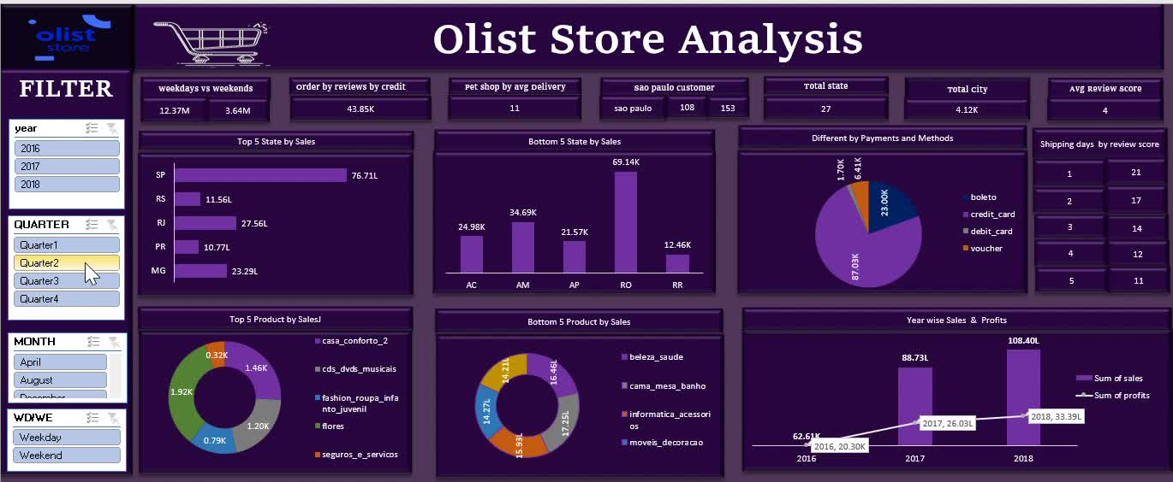
In Excel :

Slide 4
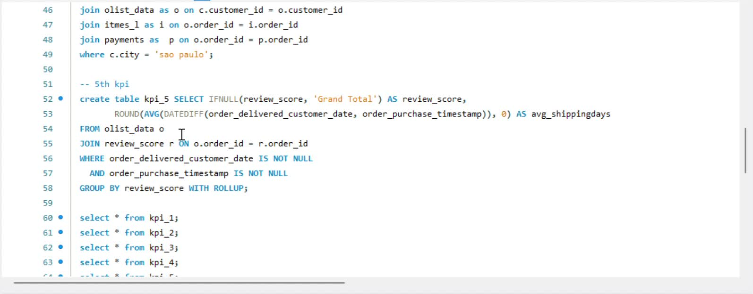
In SQL :

Slide 5
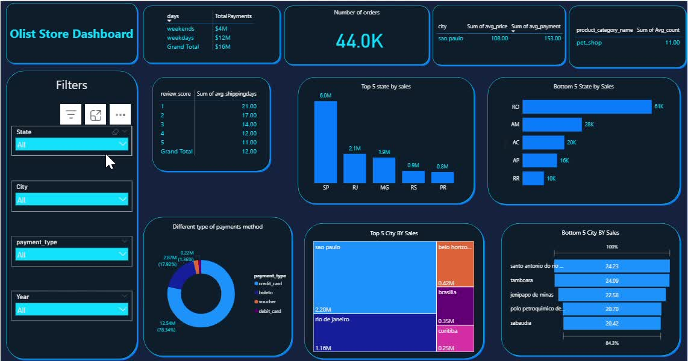
In Power BI :

Slide 6
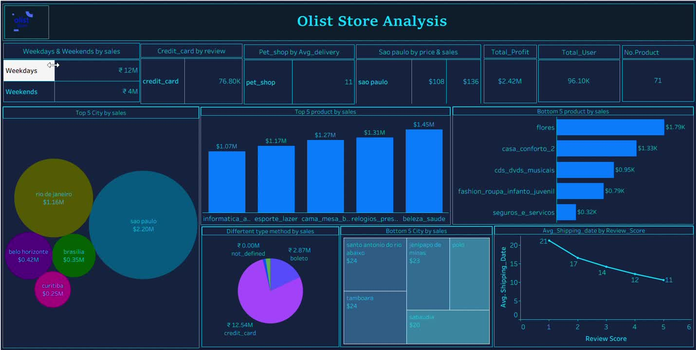
In Tableau :

Slide 7
What challenges did we face in this Project?
1. I first faced issues handling null values and duplicate records in the dataset.
2. In MySQL, I faced problems importing large data files and executing queries to get correct values.
3. In Power BI, I faced difficulties importing data from the MySQL database.

Slide 8
How I Overcame These Challenges:
1. With the help and guidance of the trainer, I solved the issues in Excel.
2. In MySQL, I fixed the problems by watching YouTube tutorials and applying what I learned.
3.With the help of Other group members, I solved the Power BI issue by installing the ODBC Data Source, uploading the database there, and then using the MySQL ODBC 9.4 ANSI Driver to successfully import the odbc data into Power BI.

Slide 9
Thank you very much!

